Slide 1
Virtual Reality with Unity 3d!
Hosted by ACM and WICSE

Slide 2
Getting Started
Install Unity Beta 5.6
https://unity3d.com/unity/beta
Android
https://developers.google.com/vr/unity/get-started
iOS
https://developers.google.com/vr/unity/get-started-ios
Must have Xcode installed to build on your iPhone
Blender
https://www.blender.org/download/
Download Game Assets

Slide 3
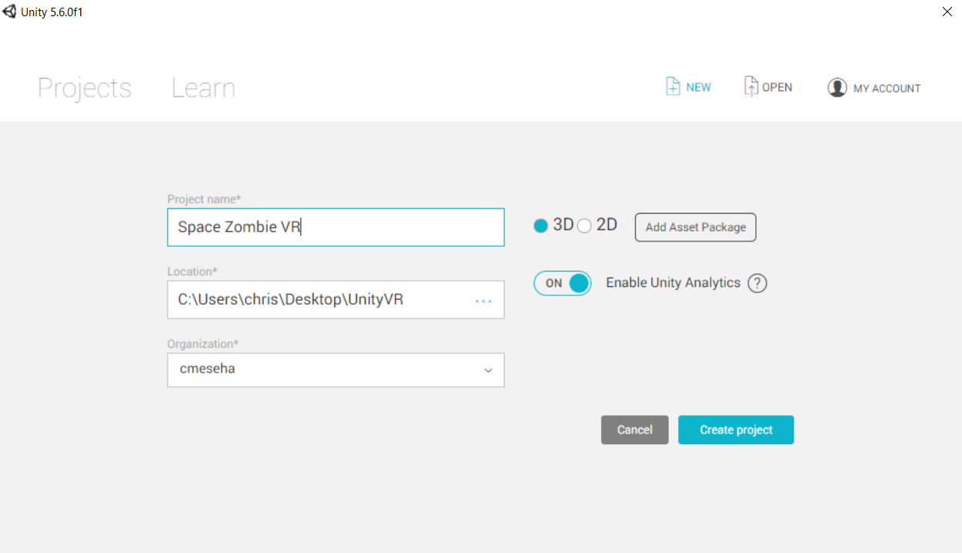
Creating the Project

Slide 4
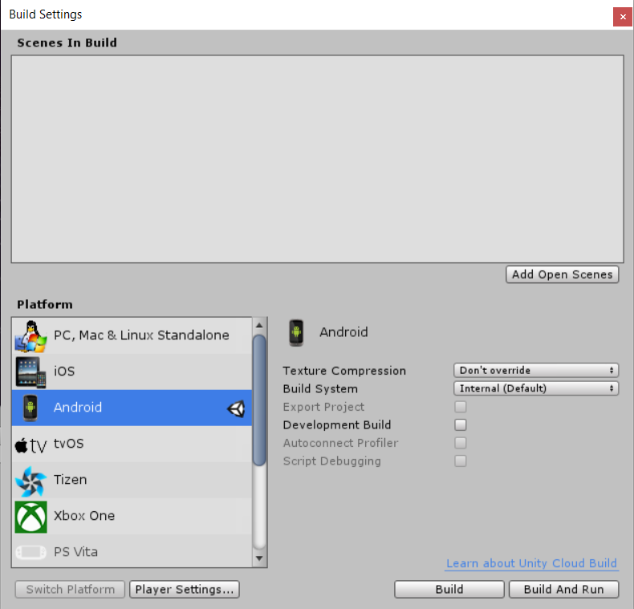
Configure Build Settings
Once scene is open, save the scene and go to build settings
Change to the specific platform you are using

Slide 5
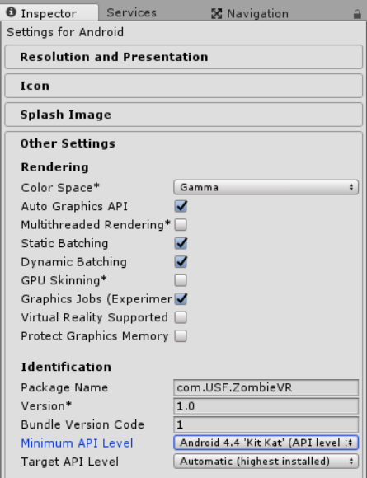
Configure Build Settings
Open Player Settings and under Other Settings, change the Package Name and Minimum API Level to Android 4.4
Note: Package name must follow the same naming convention

Slide 6
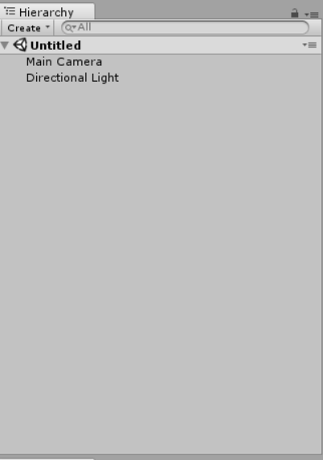
Unity - Hierarchy
The hierarchy window contains a list of every GameObject in the current Scene.
Direct instances of Asset files
Example: 3d Models
Instances of Prefabs
As objects are added / removed in the Scene, they will appear / disappear from the Hierarchy
By default, objects are listed in the hierarchy window in the order they are made
Can reorder by dragging or making child / parent objects
Changes to parent objects are applied to all children – very handy!
Delete the default light from the hierarchy

Slide 7
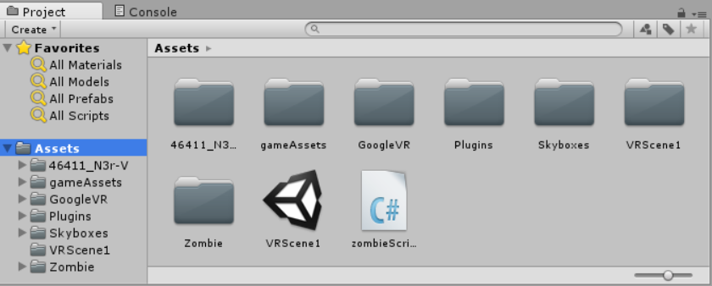
Importing Game Assets
Drag the gameAssets and gun model folders to Unity’s Assets folder
Import Google VR SDK

Slide 8
Insert GoogleVR’s prefabs into Scene
Prefabs are assets that allow you to store a GameObject obect complete with components and properties
Any edits to prefab assets are immediately reflected in all instances produced from it
Can still override components and settings for each instance individually

Slide 9
Create a new Game Object
Every object in your game is a GameObject. You give GameObjects properties before they can become a character, environment, or a special effect
Essentially a container that you add components to.
Depending on what kind of object you want to create, you add different combinations of components to a GameObject.
Insert game objects by right clicking on hierarchy and choosing from list of premade GameObjects that Unity provides or an empty GameObjects which you can fully customize with it’s own components
Right click on the hierarchy window and insert a Plane – our floor

Slide 10
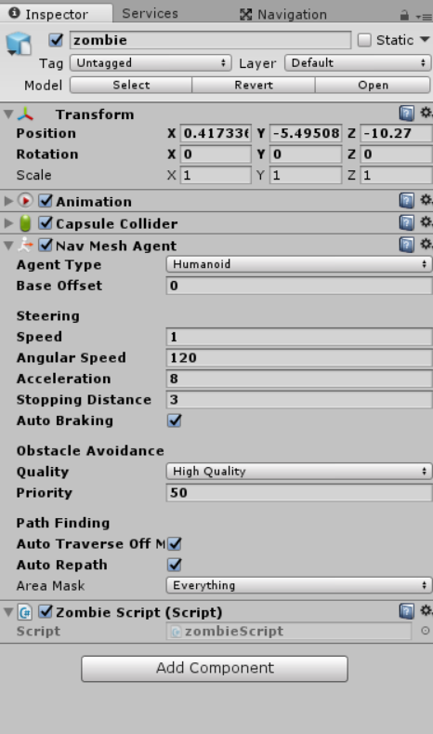
GameObject Components
Use the inspector to view / edit / add components to a GameObject

Slide 11
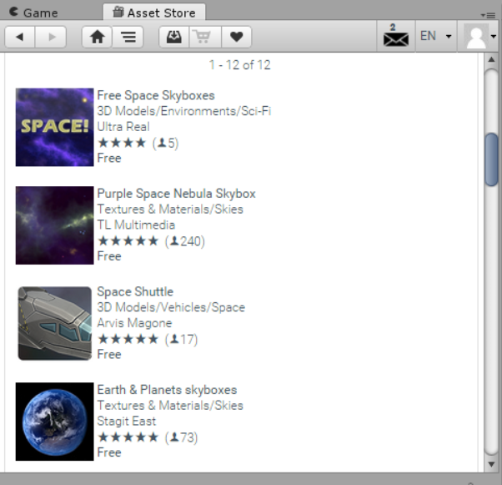
Insert SkyBox into Scene
Skybox is a wrapper around your entire scene that shows what the world looks like beyond your geometry
Mesh used to render is a box with 6 textures
Go to the Asset store and download / import a skybox into your scene
To insert skybox, just drag into scene
We will use SpaceSkies

Slide 12
Add Lighting to the scene
Light is also a GameObject
Point lights – located at a point in space and sends light out in all directions equally
Spot lights – same as point light but light is constrained to an angle = cone-shaped
Directional lights – similar to sunlight
Light Mapping
A way for games to calculate indirect light only for objects and surfaces that are known ahead of time to not move around (static)

Slide 13
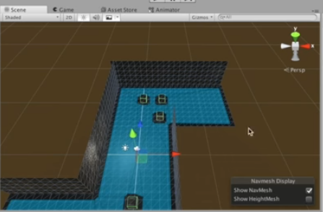
Unity’s built in AI Pathing
NavMesh Baking
Enables characters to plot a path around the various complex items in a scene.
Anything static will be avoided by the AI
Must set a destination (our camera) for the NavMeshAent (our zombie)
Relationship set in code later

Slide 14
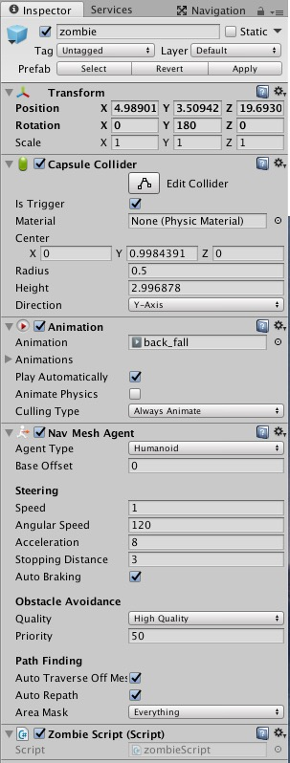
Add Zombie to Scene
Download Zombie Model from asset store
Go to Zombie -> Model -> zwalk
Expand Zwalk
Delete animator component and add animation component
Add walk and fall animation elements to animation component
Add NavMeshAgent component and set stopping distance to 3
Add Capsule Collider component to Zombie
Colliders allow Unity to detect collision with other GameObject
Add a new script component and copy / paste Zombie code
Create resources folder within Assets and drag zombie in it to create a Zombie Prefab

Slide 15
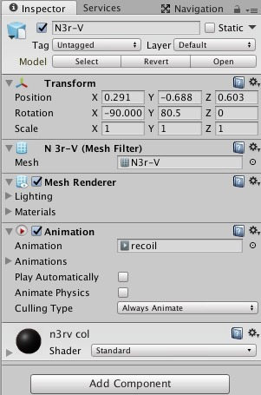
Add Gun to Scene
Only need the N3Vr gun from gun model folder
Break the prefab
Connect the gun to the Main Camera
Make the gun Main Camera’s child
Add a legacy animation component to the gun
Create the gun animation

Slide 16
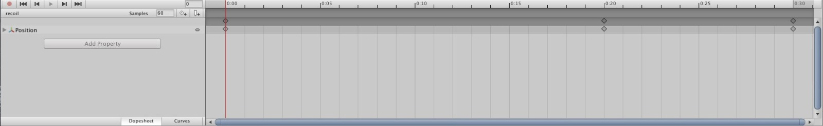
Creating the Gun Animation
Create new animation
Add an animation property – we want to move the guns position forward and back to simulate a gun’s recoil
Uncheck play automatically
Drag our new gun animation to the animation component

Slide 17
Creating Bullets
Create a spawn point so bullets spawn at the gun’s barrel
Right click on hierarchy and add a sphere object to the scene
Rescale the sphere object to .01 and rename it to spawnPoint
Disable the spawnPoint’s collider
Must rotate the Y position of the spawnPoint by -90 so that the bullets shoot forward away from the gun’s barrel.
Attach the spawnPoint to the gun by making it a child of the gun’s game object in the hierarchy.

Slide 18
Create a sight for the gun
Right click on the hierarchy and add a cube gameobject
Make the cube a child of the gun gameobject
Scale the Z to 1000 and position the sight accordingly
Recolor the cube to red

Slide 19
Adding functionality to our Player
In this case, our player is the main camera
Add a new script component to the main camera called playerScript
Copy / paste the playerScript code

Slide 20
Build & Run
You can play the game while editing at any time by pressing the play button at the top of the scene
Note: Any changes you make to the game while running can be seen in the editor HOWEVER they will not be saved
Useful for testing different positions and properties live.
To run the game on your android, File -> Build & Run
Note: Your phone must be in Developer Mode!
This is where many errors can occur, check your console if you do run into any errors

